Slide 1
Cervical Cancer Detection Using Machine Learning
Analysis and Model Implementation

Slide 2
Importance of Early Detection
Early detection of cervical cancer greatly increases the chances of successful treatment and survival.
Regular screening tests, such as Pap smears and HPV tests, can detect precancerous changes or early-stage cancer before symptoms develop.
When cervical cancer is detected early, it is highly treatable with less aggressive interventions, such as surgery, radiation therapy, or chemotherapy.
Early detection also reduces the need for extensive and invasive treatments, resulting in better quality of life for patients.

Slide 3
AGENDA
Dataset Overview
Data Preprocessing
Exploratory Data Analysis (EDA)
Model Building
Results

Slide 4
Dataset overview
Dataset Overview
Source: The dataset was obtained from https://www.kaggle.com/datasets/ranzeet013/cervical-cancer-dataset/data
Number of Samples: 835

Slide 5
Data Preprocessing
Handling Missing Values:
Importance: Missing values can affect model performance and interpretation of results.
# Replace '?' with NaN
cancer_df = cancer_df.replace('?', np.nan)
# Drop rows or columns with missing values
cancer_df.dropna(inplace=True)

Slide 6
Data Preprocessing
Data Cleaning Steps
Replacing '?' with NaN:
'?' was replaced with NaN to indicate missing values.
# Replace '?' with NaN
cancer_df = cancer_df.replace('?', np.nan)
Dropping Irrelevant Columns:
Columns such as 'STDs: Time since first diagnosis' were dropped as they were not relevant for the modeling task.
# Drop irrelevant columns
cancer_df = cancer_df.drop(columns=['STDs: Time since first diagnosis'])

Slide 7

Exploratory Data Analysis (EDA)

Slide 8
Visualizations of the Dataset
Visualizations of the Dataset
Heatmap of Missing Values
import seaborn as sns
import matplotlib.pyplot as plt
plt.figure(figsize=(10, 8))
sns.heatmap(cancer_df.isnull(), yticklabels=False, cmap='viridis', cbar=False)
plt.title('Heatmap of Missing Values’)
plt.show()

Slide 9
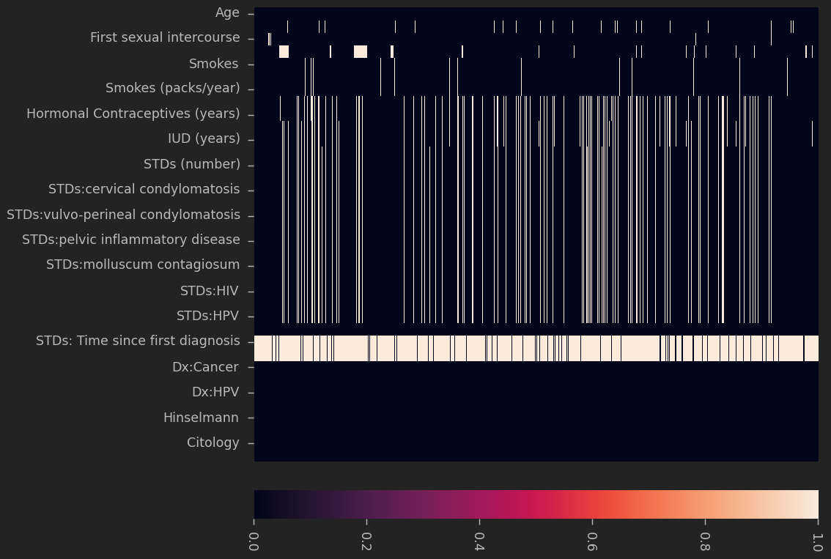
Visualizations of the Dataset
Visualizations of the Dataset
Heatmap of Missing Values
import seaborn as sns
import matplotlib.pyplot as plt
plt.figure(figsize=(10, 8))
sns.heatmap(cancer_df.isnull(), yticklabels=False, cmap='viridis', cbar=False)
plt.title('Heatmap of Missing Values’)
plt.show()

Slide 10
Visualizations of the Dataset
Visualizations of the Dataset
Histograms of Features
cancer_df.hist(bins=20, figsize=(15, 10), color='skyblue')
plt.suptitle('Histograms of Features', fontsize=16)
plt.show()

Slide 11
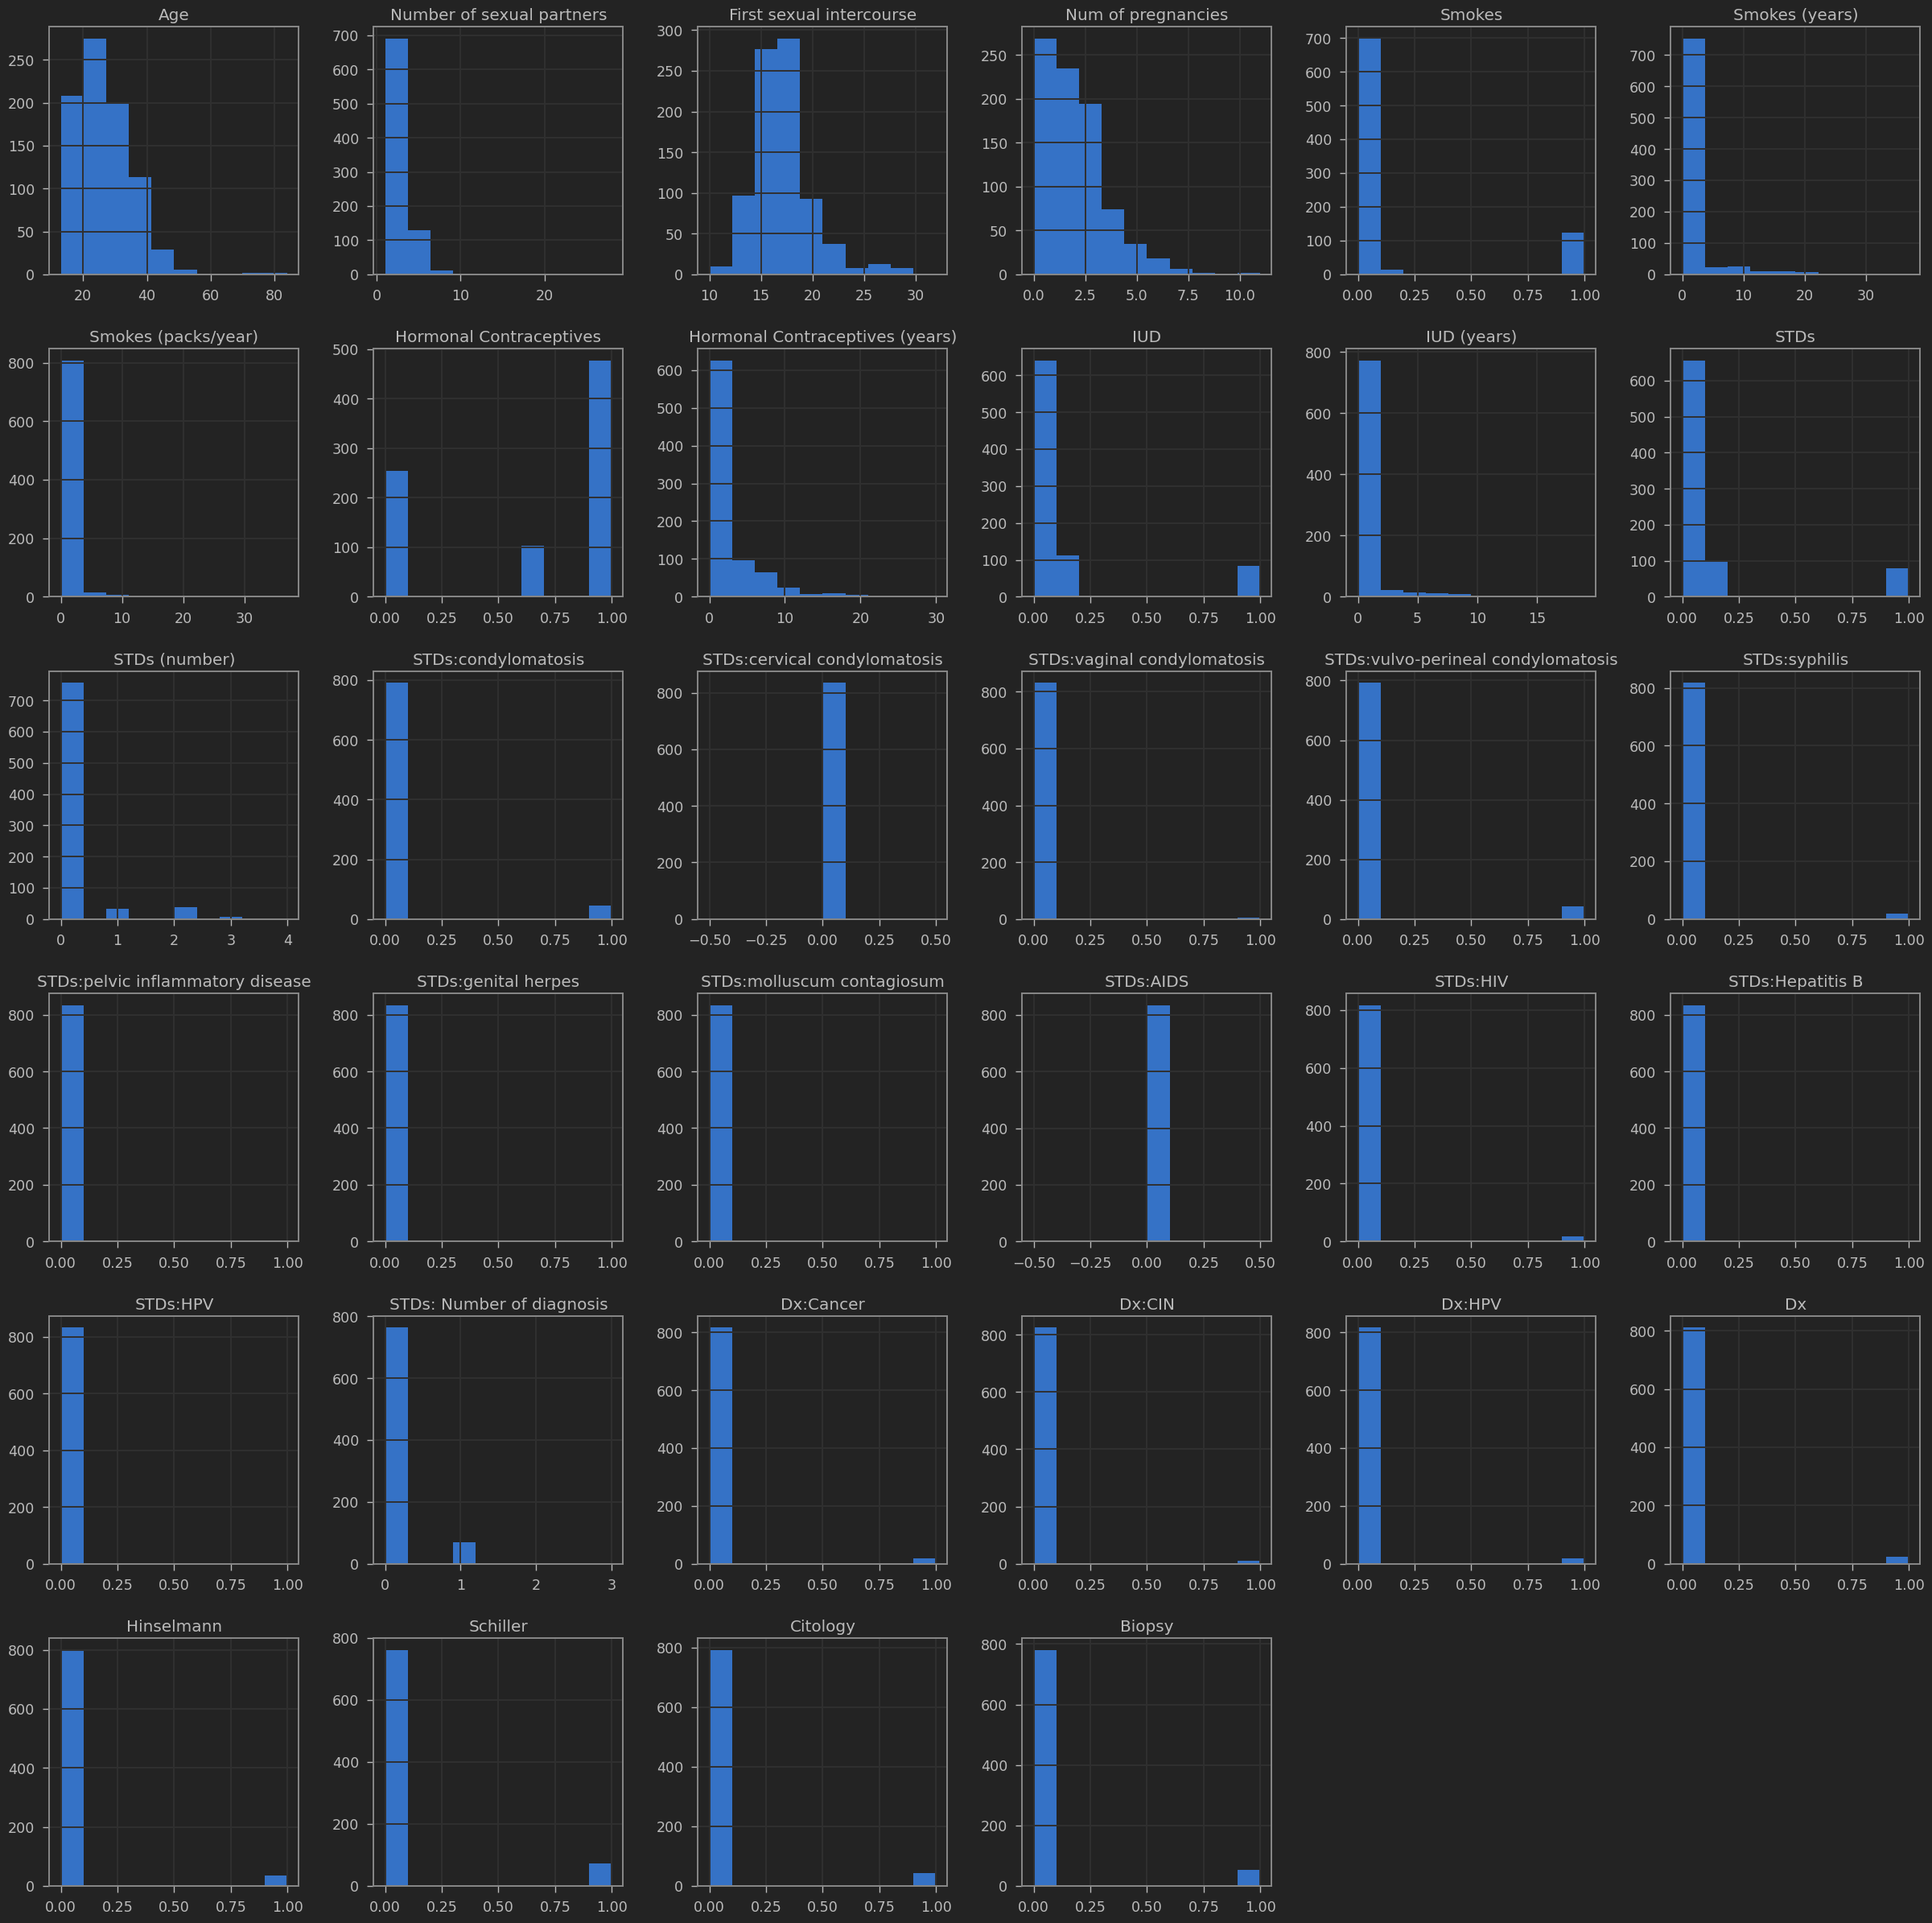

Slide 12
Visualizations of the Dataset
Correlation Analysis
Correlation Matrix
corr_matrix = cancer_df.corr()
plt.figure(figsize=(12, 10))
sns.heatmap(corr_matrix, annot=True, cmap='coolwarm', fmt=".2f")
plt.title('Correlation Matrix')
plt.show()

Slide 13
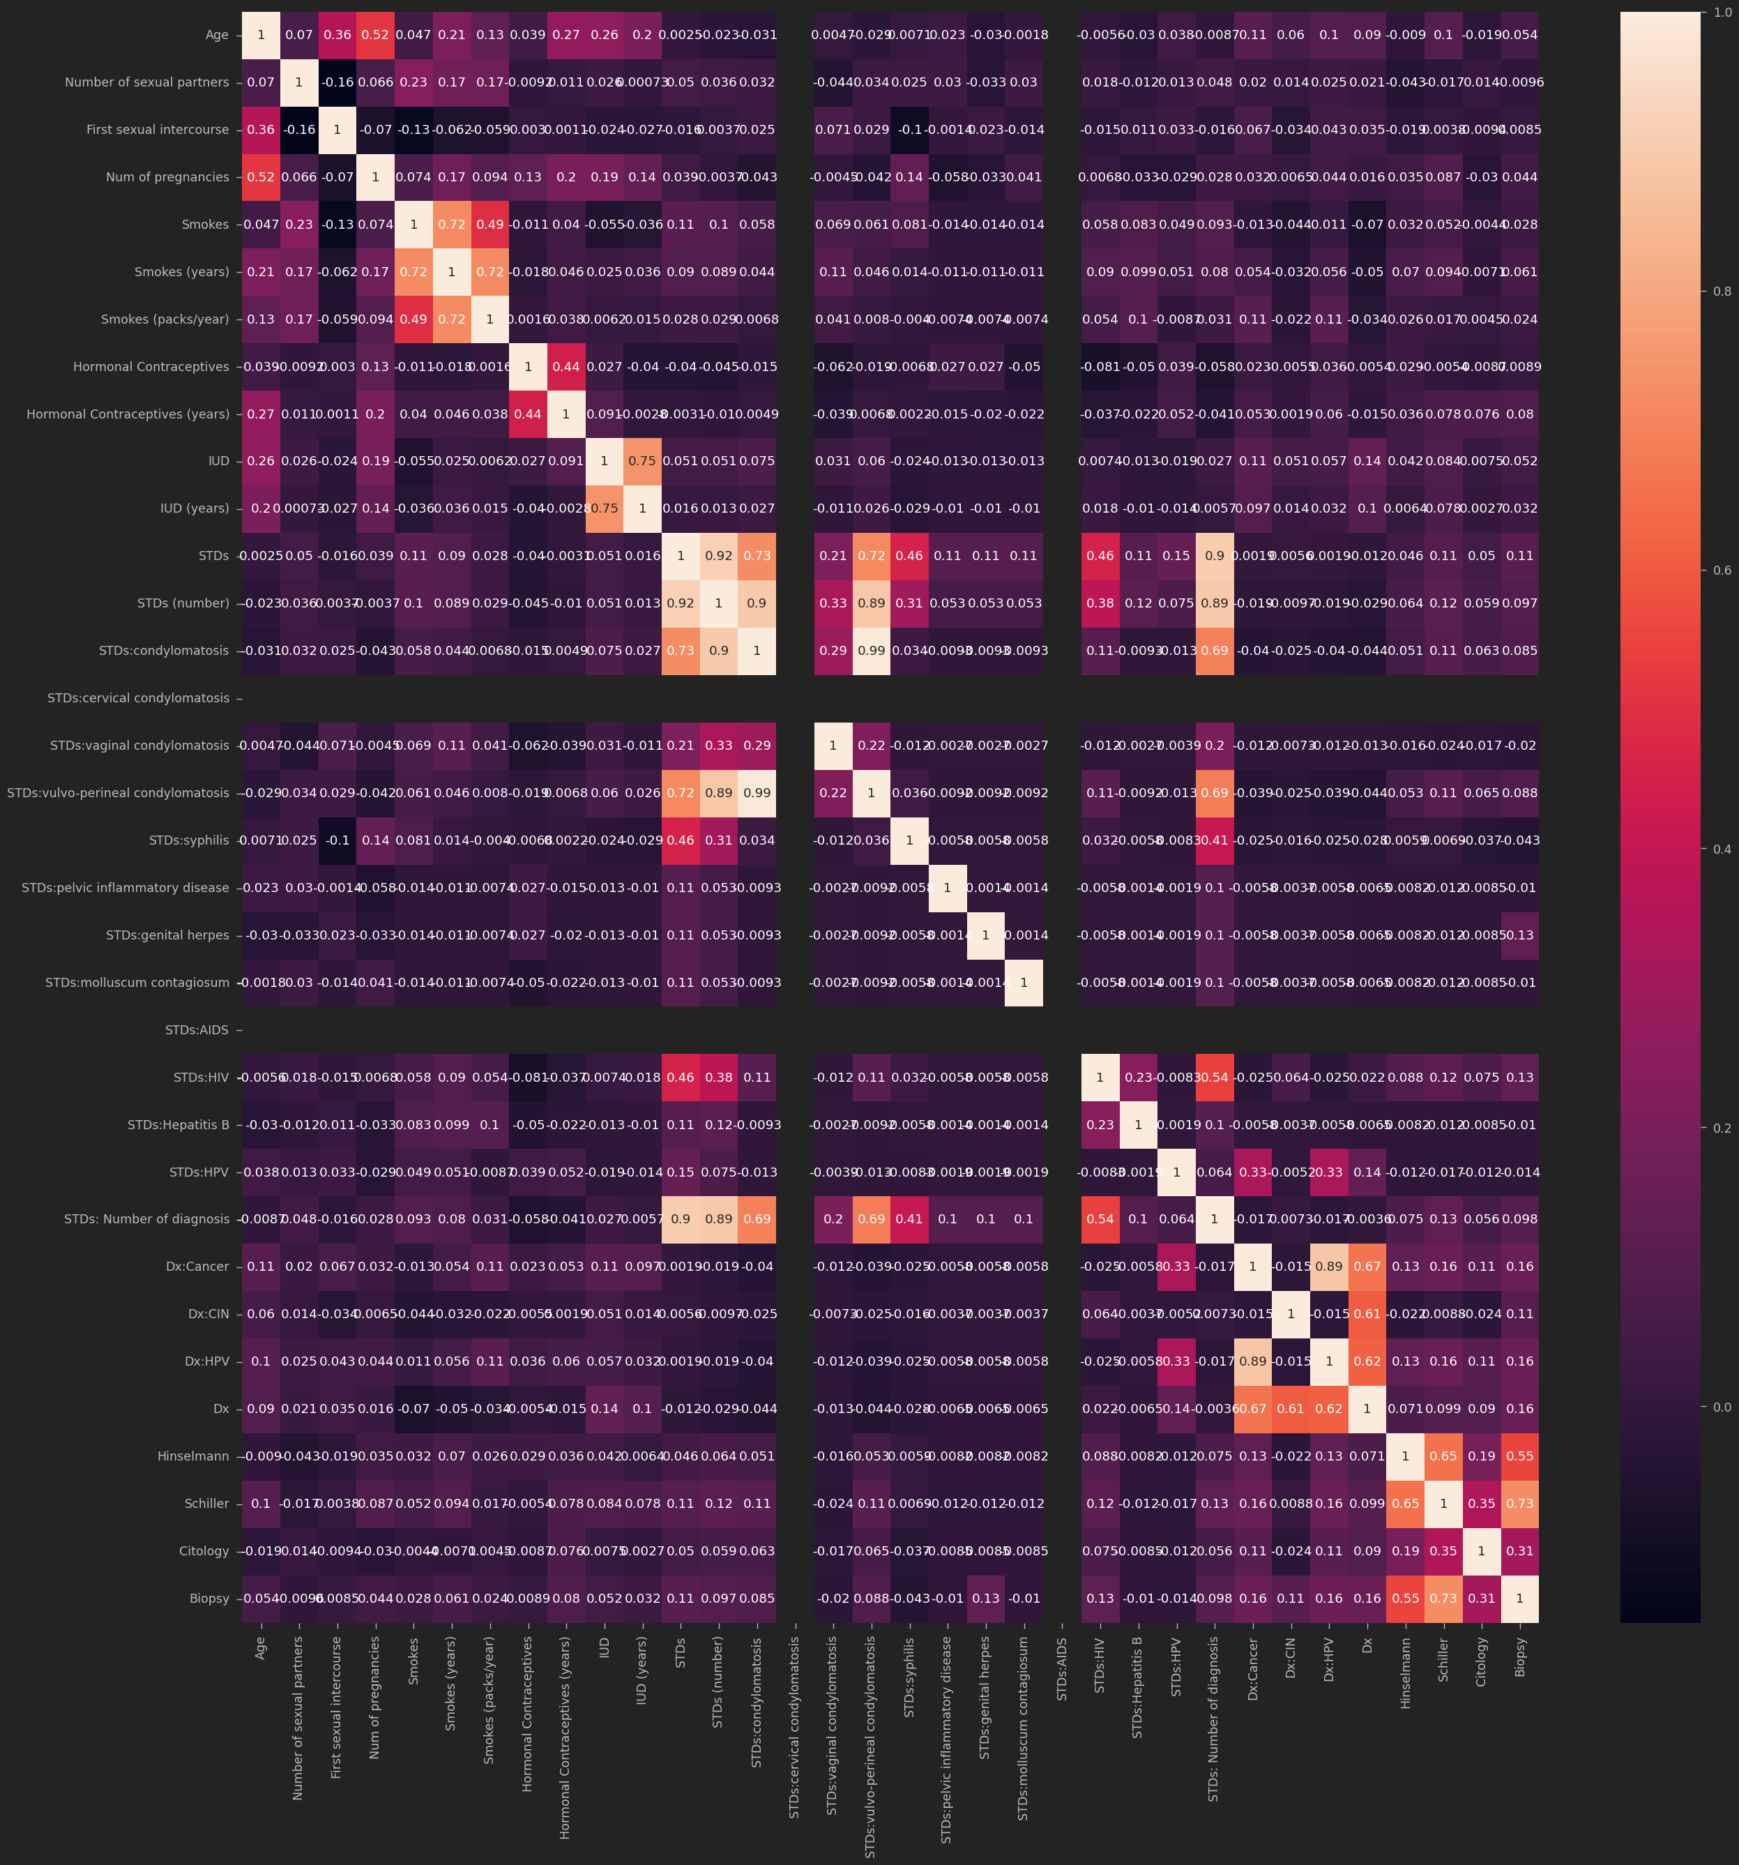

Slide 14
Model Building

Slide 15
Description of XGBoost Algorithm
XGBoost (Extreme Gradient Boosting)
XGBoost is a powerful and efficient implementation of gradient boosting algorithms designed for speed and performance.
It builds multiple weak learners (typically decision trees) sequentially, with each subsequent model correcting the errors of its predecessor.
XGBoost uses gradient descent optimization techniques to minimize a specific loss function, making it highly effective for classification tasks like cervical cancer detection.

Slide 16
Splitting the Dataset
Training, Validation, and Testing Sets
from sklearn.model_selection import train_test_split
X_train, X_test, y_train, y_test = train_test_split(X, y, test_size=0.25, random_state=42)
X_test, X_val, y_test, y_val = train_test_split(X_test, y_test, test_size=0.5, random_state=42)
Training the XGBoost Model
Training the Model
import xgboost as xgb
model = xgb.XGBClassifier(learning_rate=0.1, max_depth=50, n_estimators=100)
model.fit(X_train, y_train)

Slide 17
Model Evaluation Metrics
Accuracy, Precision, Recall, F1-Score
from sklearn.metrics import accuracy_score, precision_score, recall_score, f1_score
y_pred = model.predict(X_val)
accuracy = accuracy_score(y_val, y_pred)
precision = precision_score(y_val, y_pred)
recall = recall_score(y_val, y_pred)
f1 = f1_score(y_val, y_pred)
print("Accuracy:", accuracy)
print("Precision:", precision)
print("Recall:", recall)
print("F1-Score:", f1)

Slide 18
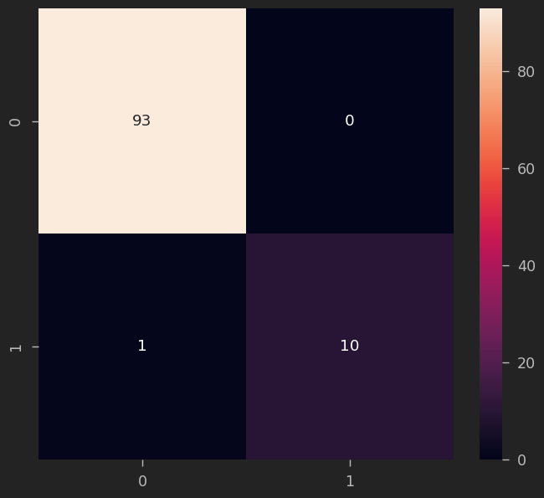
Display Confusion Matrix
Confusion Matrix
from sklearn.metrics import confusion_matrix
import seaborn as sns
cm = confusion_matrix(y_val, y_pred)
sns.heatmap(cm, annot=True, cmap='Blues')
plt.title('Confusion Matrix')
plt.xlabel('Predicted')
plt.ylabel('True')
plt.show()

Slide 19

Results
Training and Testing Accuracy Scores
Training Accuracy Score
Testing Accuracy Score
Classification Report
Precision, Recall, F1-Score

Slide 20
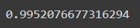
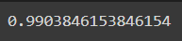
Training and Testing Accuracy Scores
Training Accuracy Score
train_accuracy = model.score(X_train, y_train)
print("Training Accuracy Score:", train_accuracy)
Training the XGBoost Model
Testing Accuracy Score
test_accuracy = model.score(X_test, y_test)
print("Testing Accuracy Score:", test_accuracy)

Slide 21
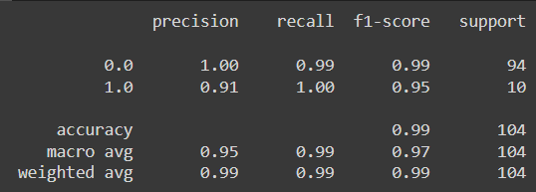
Classification Report
Precision, Recall, F1-Score
from sklearn.metrics import classification_report
y_pred_test = model.predict(X_test)
classification_rep = classification_report(y_test, y_pred_test)
print("Classification Report:\n", classification_rep)

Slide 22
Conclusion
Summary of Findings
Potential Real-World Applications
Limitations and Future Work

Slide 23
Summary of Findings
Model Performance: The XGBoost model achieved 0.9903846153846154 accuracy on the testing dataset, indicating remarkable accuracy.
Key Insights: The Correlation analysis uncovered good findings with 93 True negatives and 10 true positive along with the accuracy indicating good training.

Slide 24
RELATED WORK
A Model for Predicting Cervical Cancer Using Machine Learning Algorithms
This research evaluates the performance of five popular machine learning
algorithms: Decision Tree (DT), Random Forest (RF), Support Vector Machine (SVM),
K-Nearest Neighbors (KNN), and Logistic Regression.
Cervical Cancer Prediction Using Support Vector Machines (2018)
This research utilizes SVM for classification based on features extracted from Pap smear images
Risk Stratification for Cervical Cancer Detection Using Machine Learning Classifiers (2022)
This study compares the performance of three machine learning algorithms: Logistic Regression (reported 78.4% accuracy), Random Forest (82.1% accuracy), and XGBoost (79.2% accuracy)

Slide 25
Potential Real-World Applications
Early Detection: The developed model can potentially assist healthcare professionals in early detection and diagnosis of cervical cancer.
Resource Allocation: By accurately identifying high-risk patients, healthcare resources can be allocated more efficiently, improving patient outcomes and reducing healthcare costs.
Decision Support System: The model can serve as a decision support system for healthcare providers, aiding in treatment planning and patient management.

Slide 26
Limitations and Future Work
Data Quality: Limited availability or quality of data may have impacted model performance. Future work could involve collecting more comprehensive and diverse datasets to improve model robustness.
Model Generalization: Further evaluation on diverse datasets and external validation in clinical settings are necessary to assess the generalizability and reliability of the model.
Feature Engineering: Exploration of additional features and advanced feature engineering techniques could enhance the model's predictive capabilities and interpretability.
Interpretability: Developing methods for interpreting model predictions and providing explanations to healthcare professionals is crucial for gaining trust and acceptance in clinical practice.

Slide 27
THANK YOU
Abhijith Nair
Haneesh Kenny
Aditya Vats
Mehul Karwa
Khush Chauhan

